Slide 1
Binary Balanced Tree
Continuation
2025.02.14

Slide 2
Recap of the Previous Session
Red-Black Tree (RB).
Adelson-Velskii Landis (AVL).
Usually RB is used for implementations:
C++: std::set, std::map.
Java: TreeSet, TreeMap.
C#: SortedSet, SortedMap.
Link to documentation: .NET 9 documentation
Link to .NET9 Source Code: Link to GitHub

Slide 3

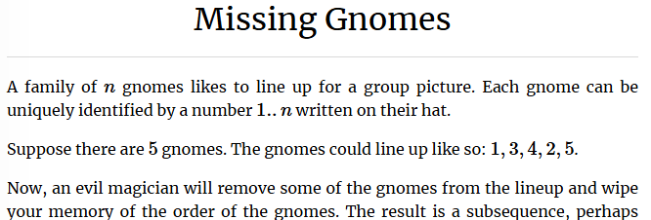
Practice BST – Missing Gnomes
Example when binary search tree (Red-Black Tree) is the only efficient solution (no priority queue or hash table).
Kattis: Missing Gnomes

Slide 4
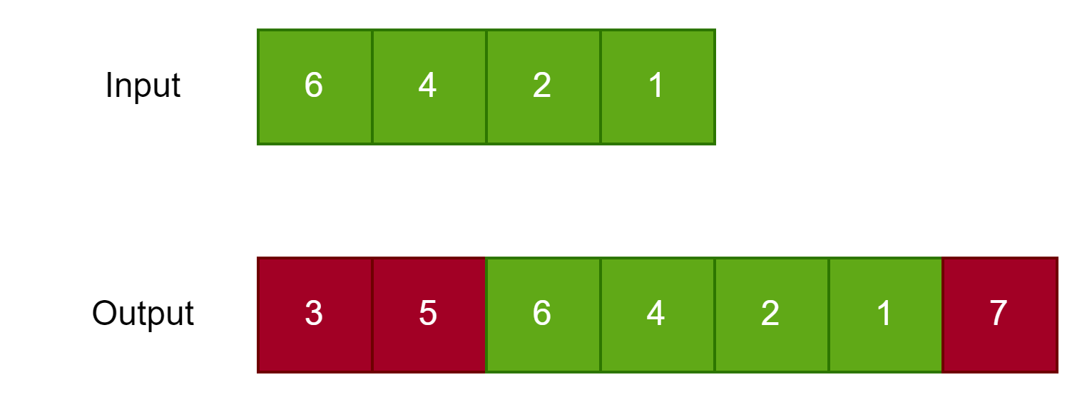
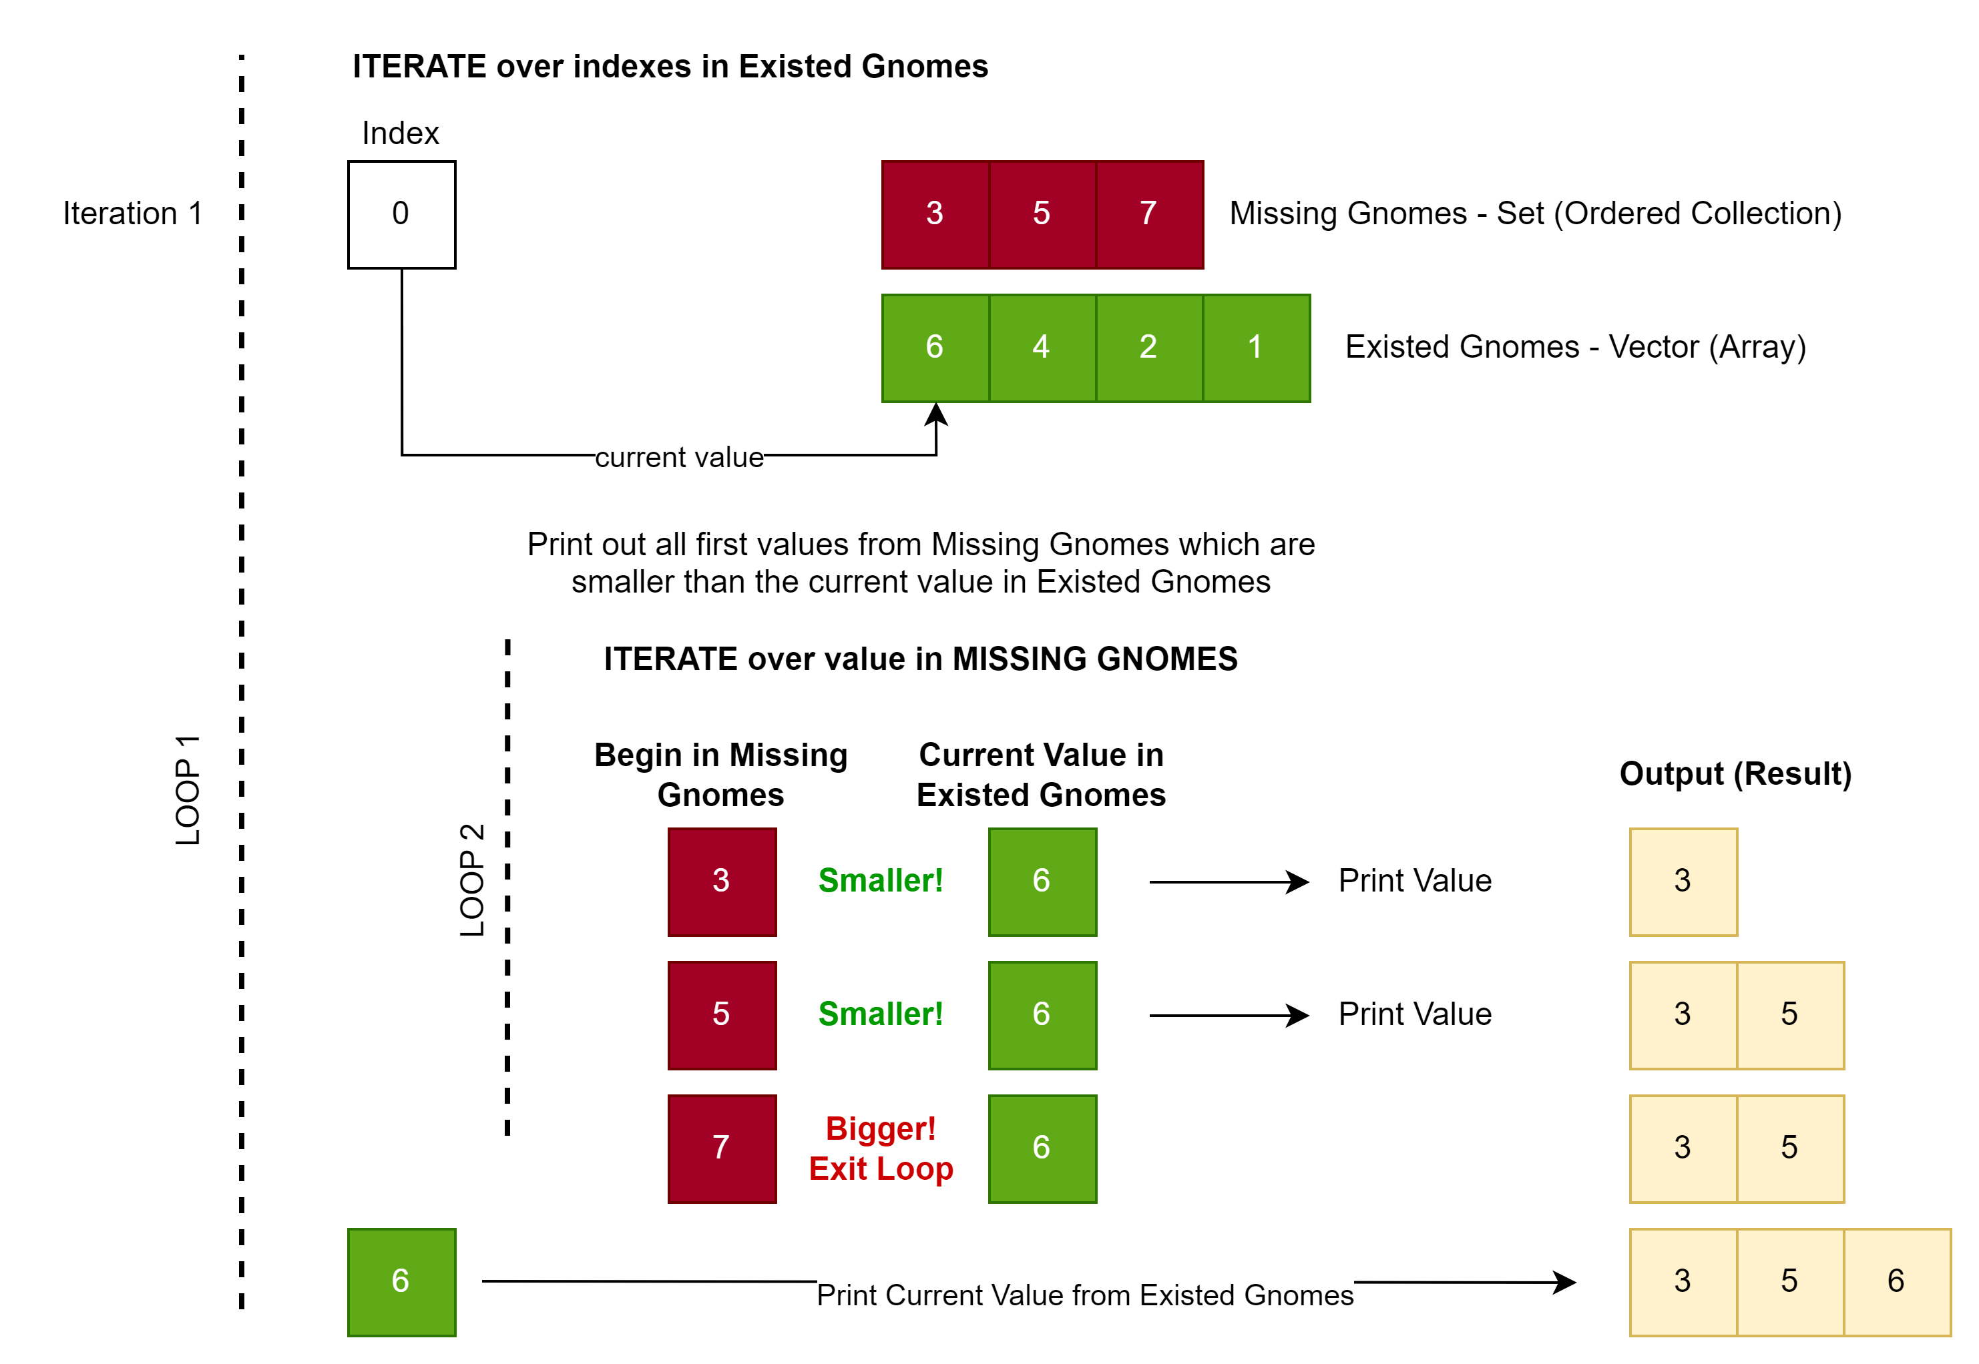
Missing Gnomes – Approach

Slide 5
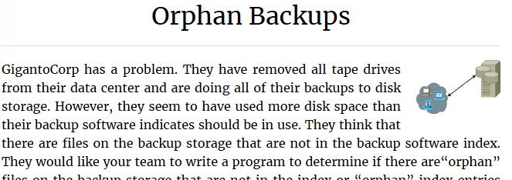
Practice BST – Orphan Backups
Example when binary search tree (Red-Black Tree) is the only efficient solution (no priority queue or hash table).
Kattis: Orphan Backups

Slide 6
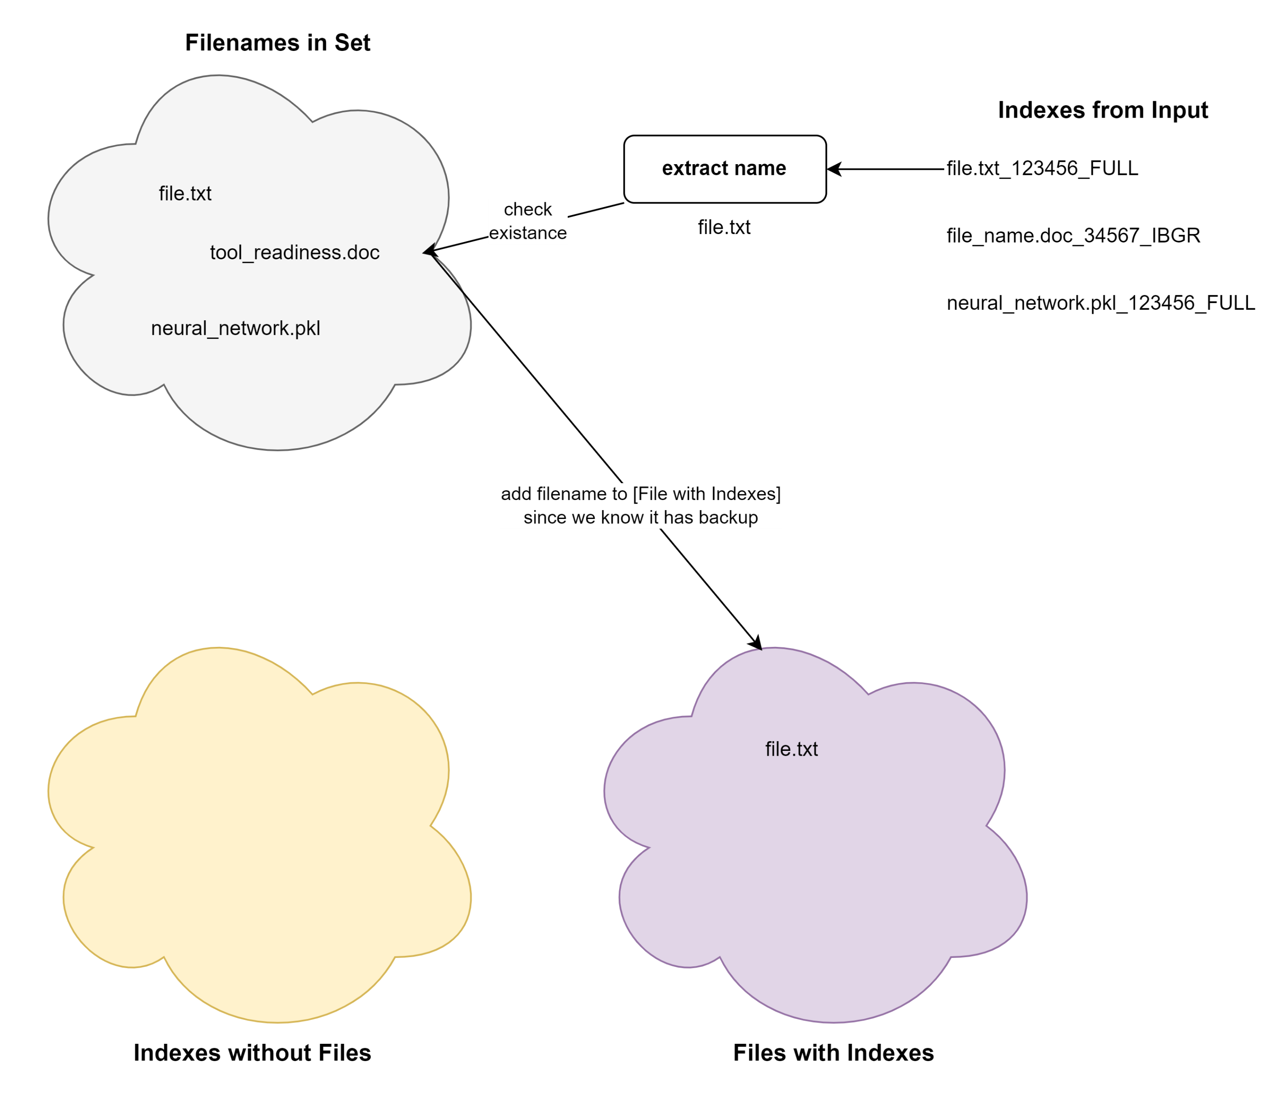
Orphan Backups – Approach – Slide 1/3

Slide 7
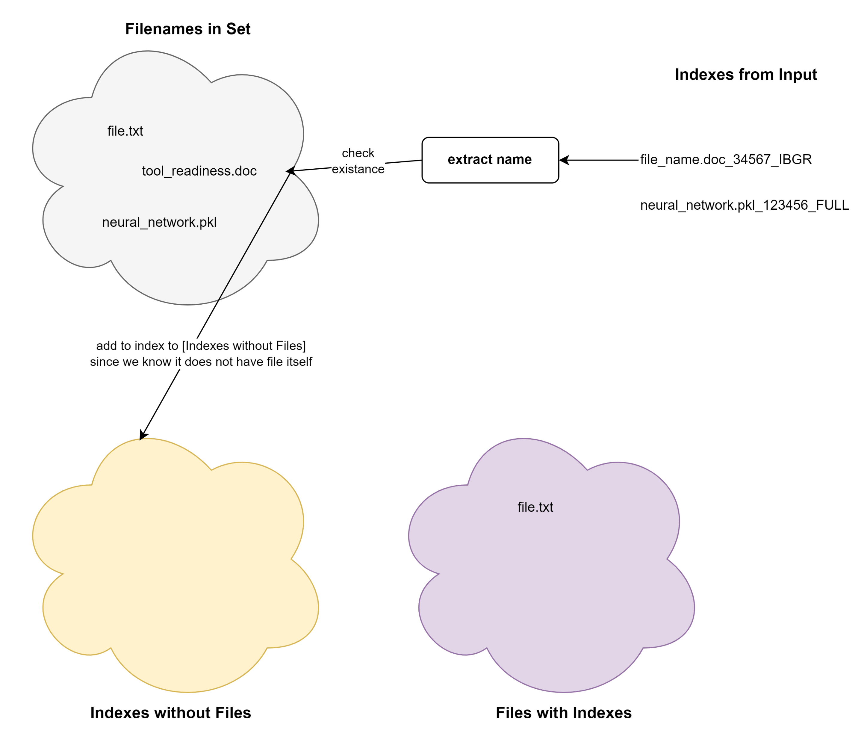
Orphan Backups – Approach – Slide 2/3
file_name.doc_3456_IBGR

Slide 8
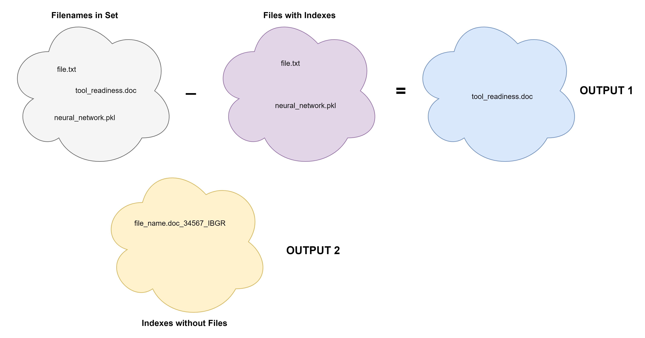
Orphan Backups – Approach – Slide 3/3

